Slide 1
Initial Expedition Training Introduction
Uncontrolled copy not subject to amendment
Version 2.0 OCT 2014

Slide 2
What is IET about?
Initial Expedition Training prepares you to
undertake self-sufficient expeditions
in the UK and abroad

Slide 3
What is an expedition?
An expedition is generally a journey with an aim

Slide 4
Why do we undertake expeditions?
Expeditions are used by all branches of the UK military to help train and develop the people who serve.
Expeditions help you to develop:
● Teamwork skills
● A spirit of adventure
● Courage
● Organisational skills
● Independence
● Resilience
● Adaptability

Slide 5
These characteristics are central to two of the ACOs core aims.
They are also looked on very favourably by civilian employers.

Slide 6
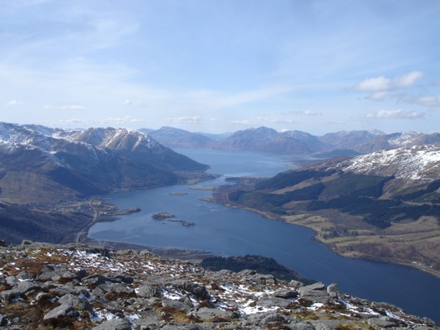
How does this fit into the Air Cadet Organisation?
National Navigation Award Scheme
Nijmegen marches
Duke of Edinburgh Award
Expedition section
Sponsored events such as the Poppy Appeal Walks
And finally ... just because it’s there

Slide 7
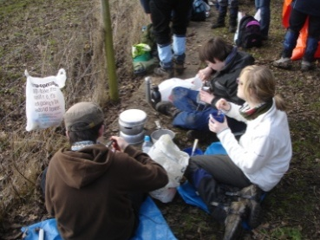
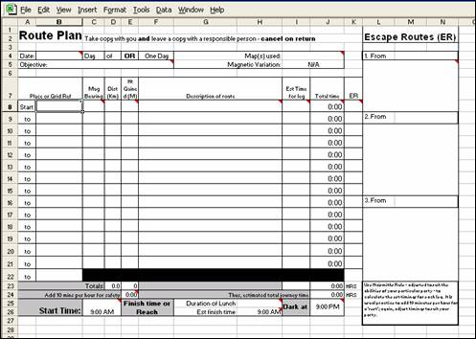
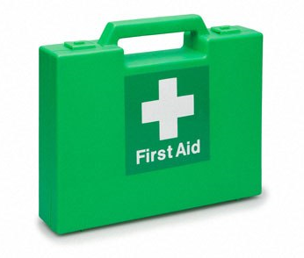
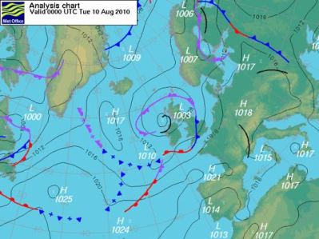
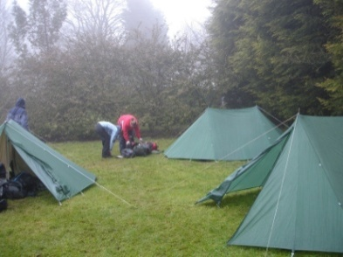
There are a number of key skills that you need:
Food and cooking
Route planning
Selecting kit
Expedition first aid
Weather forecasts
Campcraft
By the time you finish this course, you should understand what these skills entail, know who to approach for answers and be ready to train for your first practice expedition for the Bronze DoE award.

